Slide 1
HOUSEKEEPING
Attendance will be taken using the Microsoft Form link provided in the Webex chat. Please take the time to complete the form. This attendance sheet will be posted on our DDC website.
Please stay muted and keep your camera off.
Please hold all questions to the end of the presentation to assist our team with monitoring and consolidating duplicate questions. Questions will be accepted in writing via the "chat" function.
Please be advised that anything discussed verbally in this meeting will not constitute a change to the RFQ document. Formal changes to the RFQ will only be made through addenda posted in PASSPort.
1

Slide 2
P R E - S U B M I S S I O N C O N F E R E N C E
Request for Qualifications of Design Build Services for
Infrastructure Project: Citywide Raised Crosswalks
Raised Crosswalks
PROJECT: HWCRCDB PIN: 8502023HW0029P
Eric Adams
Mayor
Thomas Foley, P.E.
Commissioner
Eric C Macfarlane, P.E. MASCE, NAC, ENV-SP First Deputy Commissioner
August 2023

Slide 3
AGENDA
Welcome & Introduction Luis Sanchez, P.E., Associate Commissioner
Design-Build Program Overview Stella Uwaechie, Deputy Director
Project Overview Luis Sanchez, P.E., Associate Commissioner
General Procurement Information Judy Lee, Deputy Agency Chief Contracting Officer
M/WBE Ding (Steven) Zheng, M/WBE Outreach and Compliance Analyst
Q&A
3

Slide 4
D B P R O G R A M O V E R V I E W
Stella Uwaechie,
Deputy Director, Infrastructure
Eric Adams
Mayor
Thomas Foley, P.E.
Commissioner
Eric C Macfarlane, P.E. MASCE, NAC, ENV-SP First Deputy Commissioner
August 2023

Slide 5
DDC DESIGN-BUILD
Teaming for Design-Build
There is no role-requirement for the leadership of the DB team; for example, teams may be designer-led.
Proposed DB team members are not required to have prior experience working together.
HINT: If members of the DB Team do not have extensive experience collaborating on projects, the Proposer shall explain the relationship and rationale for teaming.
5

Slide 6
DDC DESIGN-BUILD
Teaming for Design-Build
It is desirable that the DB Team have collective experience in DB and DB-based project delivery methods and other alternative project delivery methods.
If key members of the DB Team do not have experience in DB and DB-based project delivery, the Proposer shall indicate familiarity with the objectives of this alternative delivery approach and demonstrate an understanding of the interrelationship between design and construction under the DB project delivery approach.
6

Slide 7
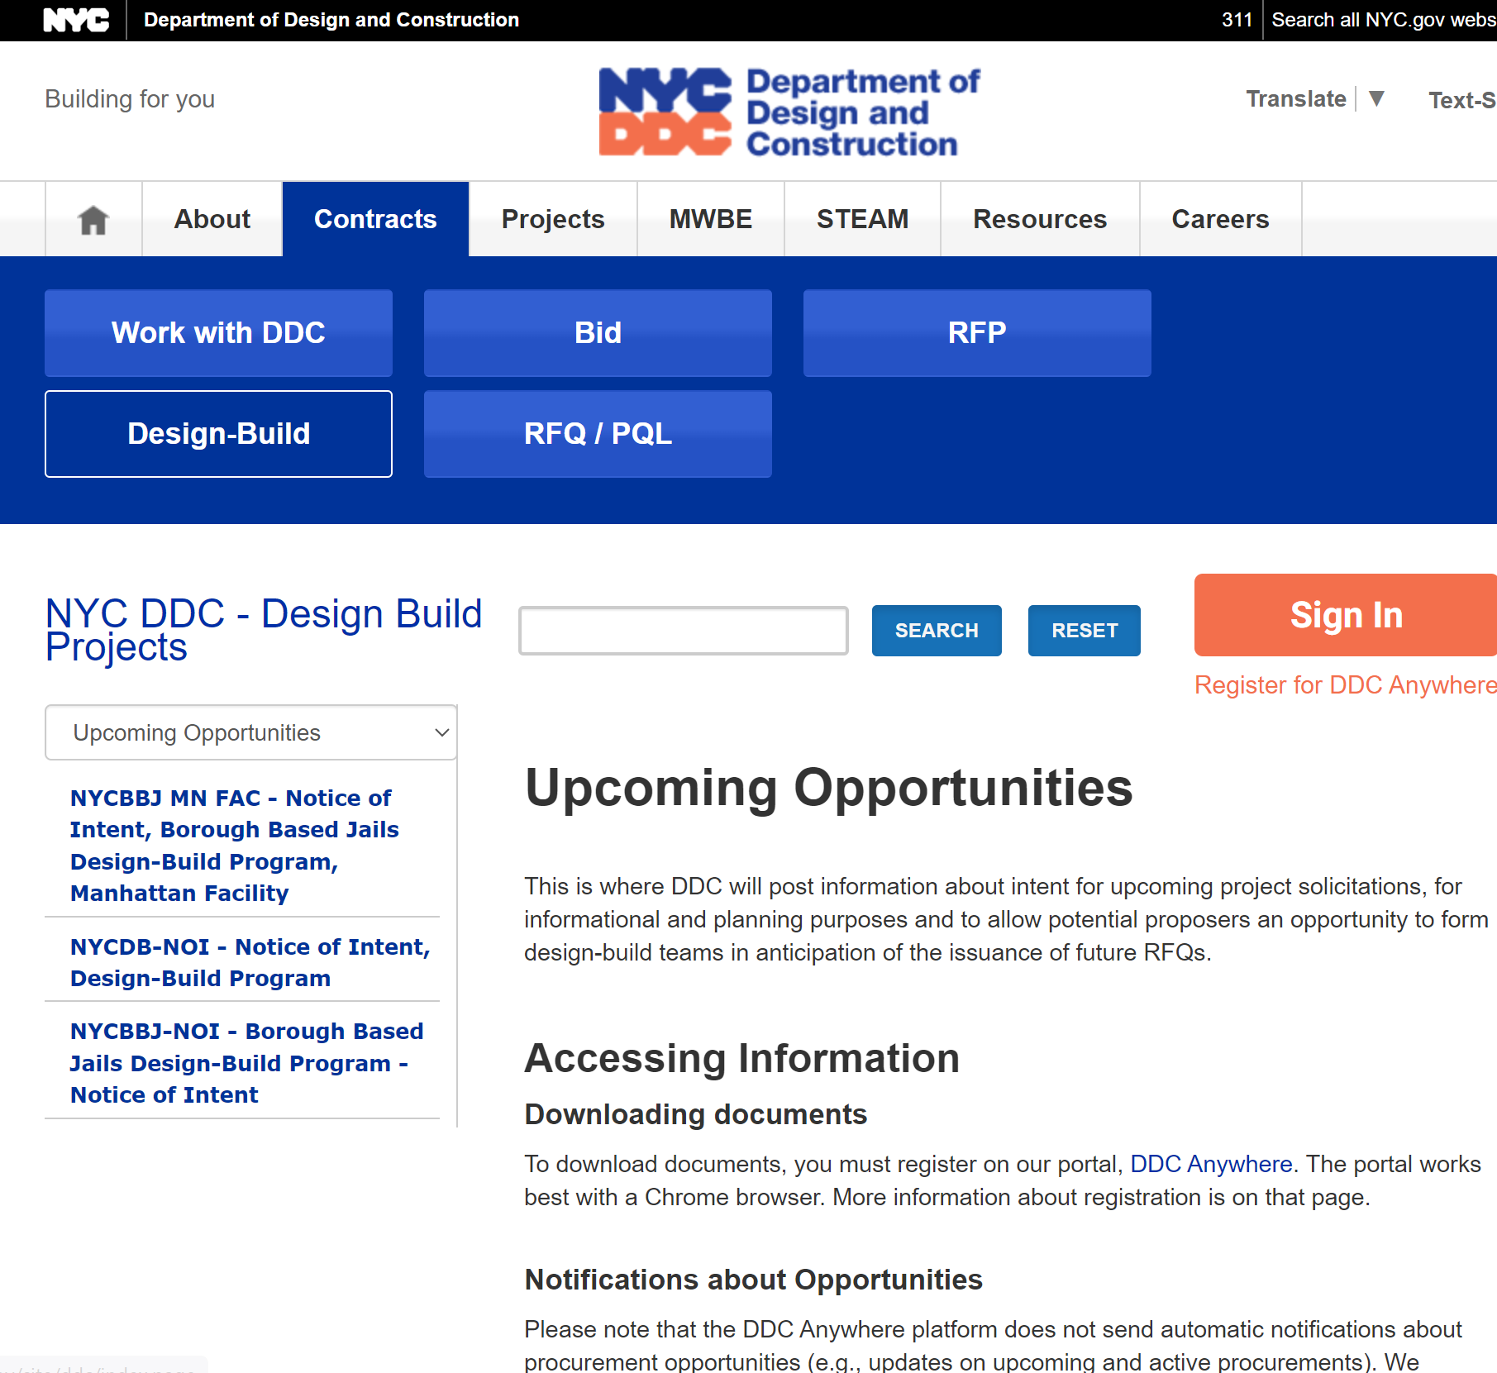
DDC DESIGN-BUILD
Potential/Upcoming Design-Build Projects
Updated Notice Of Intent will be released quarterly on our DDC Website.
https://designbuild.ddcanywhere.nyc/?SearchString=&ProjectStatus=All-Upcome-PRJs
7

Slide 8
DDC DESIGN-BUILD
Two-step procurement
Request for Qualifications (RFQ)
Request for Proposals (RFP)
At the RFQ step, limited project information is provided to allow proposers to assemble a qualified team
At the RFP step, extensive project information will be released to the shortlisted teams
8

Slide 9
DESIGN-BUILD AT DDC
Design-Build Two-Stage Procurement
RFQ
Released
Shortlist / RFP
Released
SOQ Due
RFQ
Dev’t
RFQ In
Market
RFQ
Evaluation
Proposals Due
Selection
Award
NTP
RFP Development
RFP In Market
Evaluation
Selection
Conformance
Contract
RFQ
RFP
Award / NTP
9

Slide 10
DESIGN-BUILD PROCUREMENT: STAGE 1 - RFQ
RFQ
Released
SOQ Due
RFQ Evaluation Draft RFP
RFP In Market
Evaluation
Selection
Conformance
Contract
Project Information
Overview and Goals
Project Description and Scope
Schedule and Budget
Procurement Information
Procurement Stages
Evaluation Process
Procurement Instructions
Submission Requirements
SOQ Contents and Format
Project-Specific
DDC Standard for DB Procurements
(Project-Specific Modifications)
Procurement Rules and Legal Requirements
DDC Standard for all Procurements
10

Slide 11
DESIGN-BUILD PROCUREMENT: STAGE 1 - RFQ
SOQ Due
RFQ Evaluation Draft RFP
RFP In Market
Evaluation
Selection
Conformance
Contract
Fundamental Qualifications or Pass/Fail (including financial, legal, teaming)
Design-Build Approach
Key Personnel and Team Organization
Project Experience and Past Performance
M/WBE Program Experience and Approach
11

Slide 12
DESIGN-BUILD PROCUREMENT: STAGE 2 - RFP
RFP Released
Shortlist
RFQ Evaluation Draft RFP
RFP In Market
Evaluation
Selection
Conformance
Contract
Instructions to Proposers
Design-Build Agreement
Standard Project Requirements
Safety, management, documentation, payments, sustainability, environmental, commissioning, etc.
Specific Project Requirements
Scoping or Bridging Documents
Project Schedule
Reference Documents
ULURP, reference standards, best practices
Available Documents
CPSD, surveys, geotechnical reports, etc.
DDC Standard
Project-Specific
12

Slide 13
DESIGN-BUILD PROCUREMENT: STAGE 2 - RFP
RFP Released
Proposals Due
RFQ Evaluation Draft RFP
RFP In Market
Evaluation
Selection
Conformance
Contract
Collaborative Dialog Meetings
Confidential
Design, technical, legal
Request For Information (RFIs)
Alternative Technical Concepts (ATCs)
DEFINITIONS: Alternative Technical Concepts are innovative solutions that are equal or better than the proposed design or construction criteria
13

Slide 14
DESIGN-BUILD PROCUREMENT: STAGE 2 - RFP
Proposals Due
RFQ Evaluation Draft RFP
RFP In Market
Evaluation
Selection
Conformance
Contract
Administrative Proposal
Team Legal and Financial Information
Technical Proposal
Design Approach Summary and Presentation
Drawings
Outline Specifications
Life-Cycle Costs
Schedule
Construction Solution
Team Structure, Experience, and Key Personnel
Guaranteed Maximum Price Proposal
Phase 1 Price
Concurrence DB can meet GMP
Proposal Phase
DDC sets GMP in RFP
DB Team selected based on:
Qualifications
Technical Solution
Concurrence DB can meet GMP
14

Slide 15
DB PROCUREMENT: STAGE 2 - RFP
Proposals Due
Selection
RFQ Evaluation Draft RFP
RFP In Market
Evaluation
Selection
Conformance
Contract
Technical Evaluation
Design, Schedule and Logistics, Team Experience, Financial Strength, Price/Value Reasonableness
Selection
Best Value Determination
15

Slide 16
DB PROCUREMENT: AWARD
Proposals Due
Selection
Award
NTP
RFQ Evaluation Draft RFP
RFP In Market
Evaluation
Selection
Conformance
Contract
Negotiation
Limited negotiations if initiated by DDC
Conformance
Minor changes to the contract documents if needed
Award
Execution
Registration
16

Slide 17
DB EXECUTION: POST AWARD
Selection
Award
NTP
RFQ Evaluation Draft RFP
RFP In Market
Evaluation
Selection
Conformance
Contract
Guaranteed Maximum Price (GMP) Phasing
Phase I
Site Investigation
Design
“Open Book” pricing provided at Design Milestones
At Design Completion, Phase II Price Set (at or below GMP)
Phase II
Construction Work Performed
17

Slide 18
P R O J E C T O V E R V I E W
Luis Sanchez, P.E., Associate Commissioner
Program Administration, Infrastructure
Eric Adams
Mayor
Thomas Foley, P.E.
Commissioner
Eric C Macfarlane, P.E. MASCE, NAC, ENV-SP First Deputy Commissioner
August 2 0 2 3

Slide 19
DDC DESIGN-BUILD RAISED CROSSWALKS
HWCRCDB Scope of Work
Construct Raised Crosswalk on one leg of an intersection.
Construct ADA Compliant pedestrian ramps at all corners of the intersection.
Install Audible Pedestrian Signals at all signalized intersection.
Include incidental work such as:
Private and public utility relocations/adjustments to facilitate installation of raised crosswalk and pedestrian ramps
Grading and Drainage modification to ensure positive flow
Anticipate an approximate range of 100-125 intersections throughout all five boroughs.
Actual locations to be provided In RFP stage.
19

Slide 20
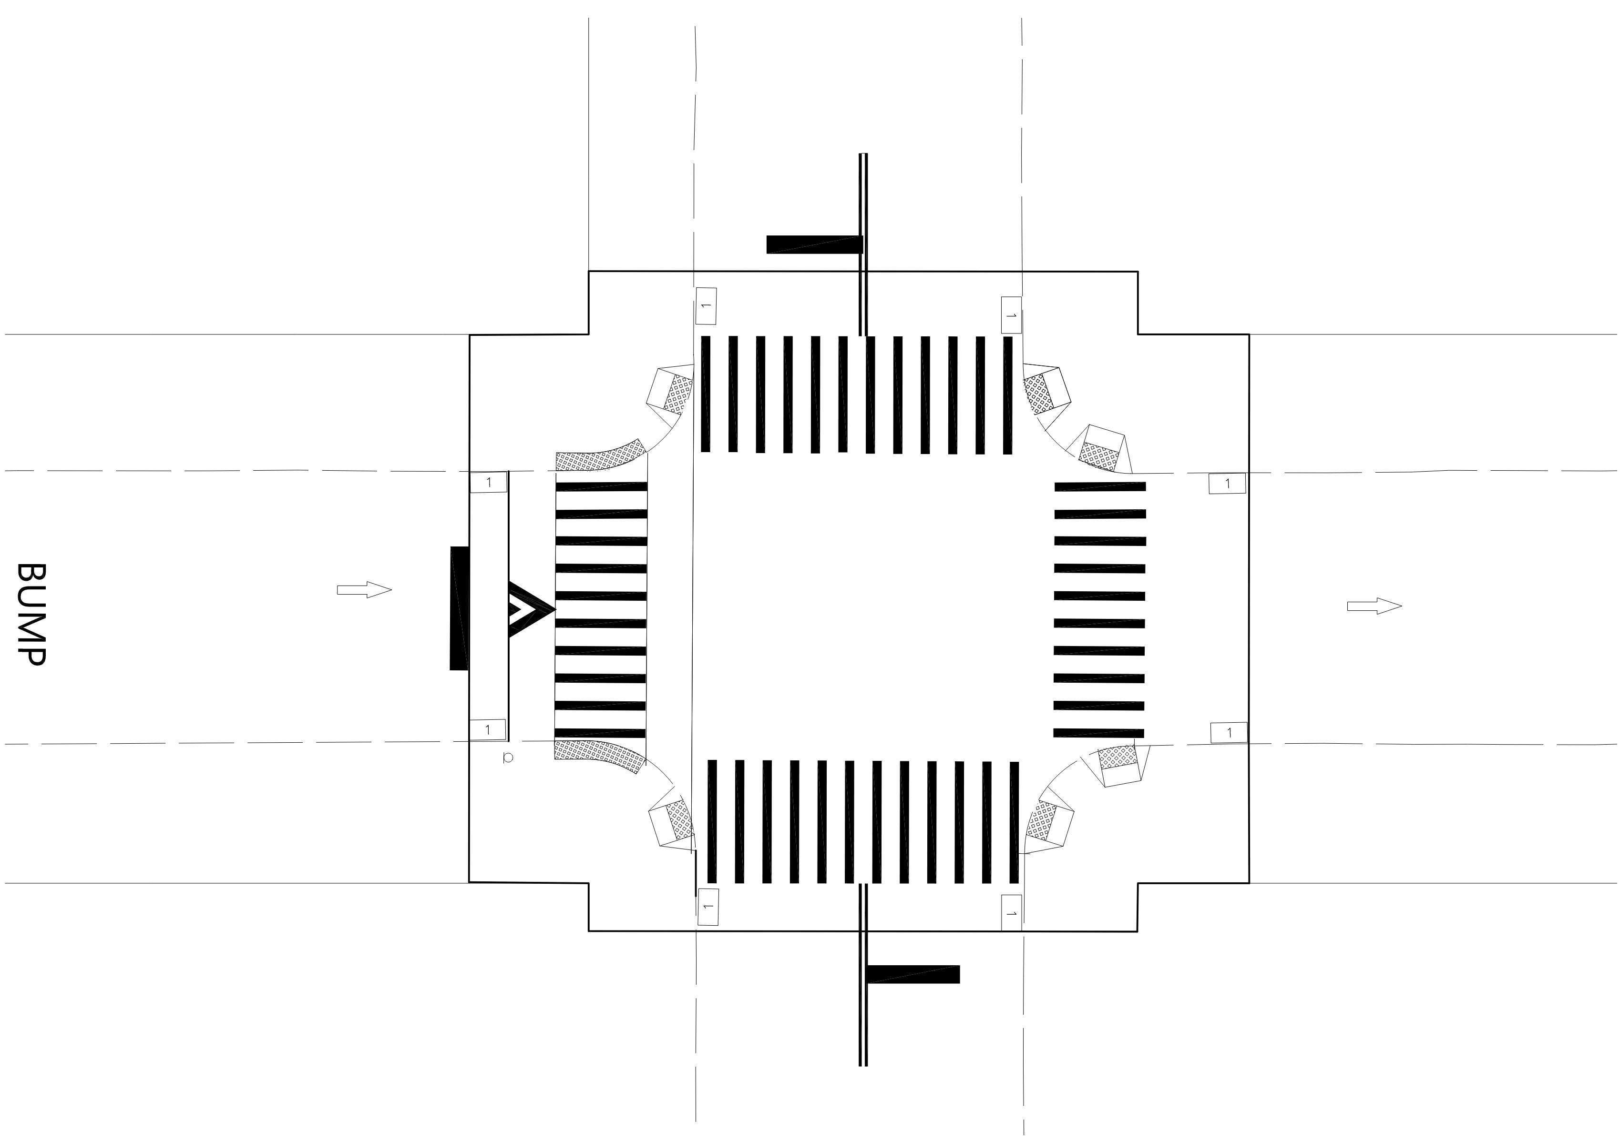
DDC DESIGN-BUILD RAISED CROSSWALKS
HWCRCDB Scope of Work
Install ADA Compliant Pedestrian Ramps at all corners
Install APS at all signalized intersection
Install Raised Crosswalk
Incidental Scope of Work
Utility Relocations/Adjustments
Grading and Drainage
Pavement Marking and Signage
Approximate Limit of Work
20

Slide 21
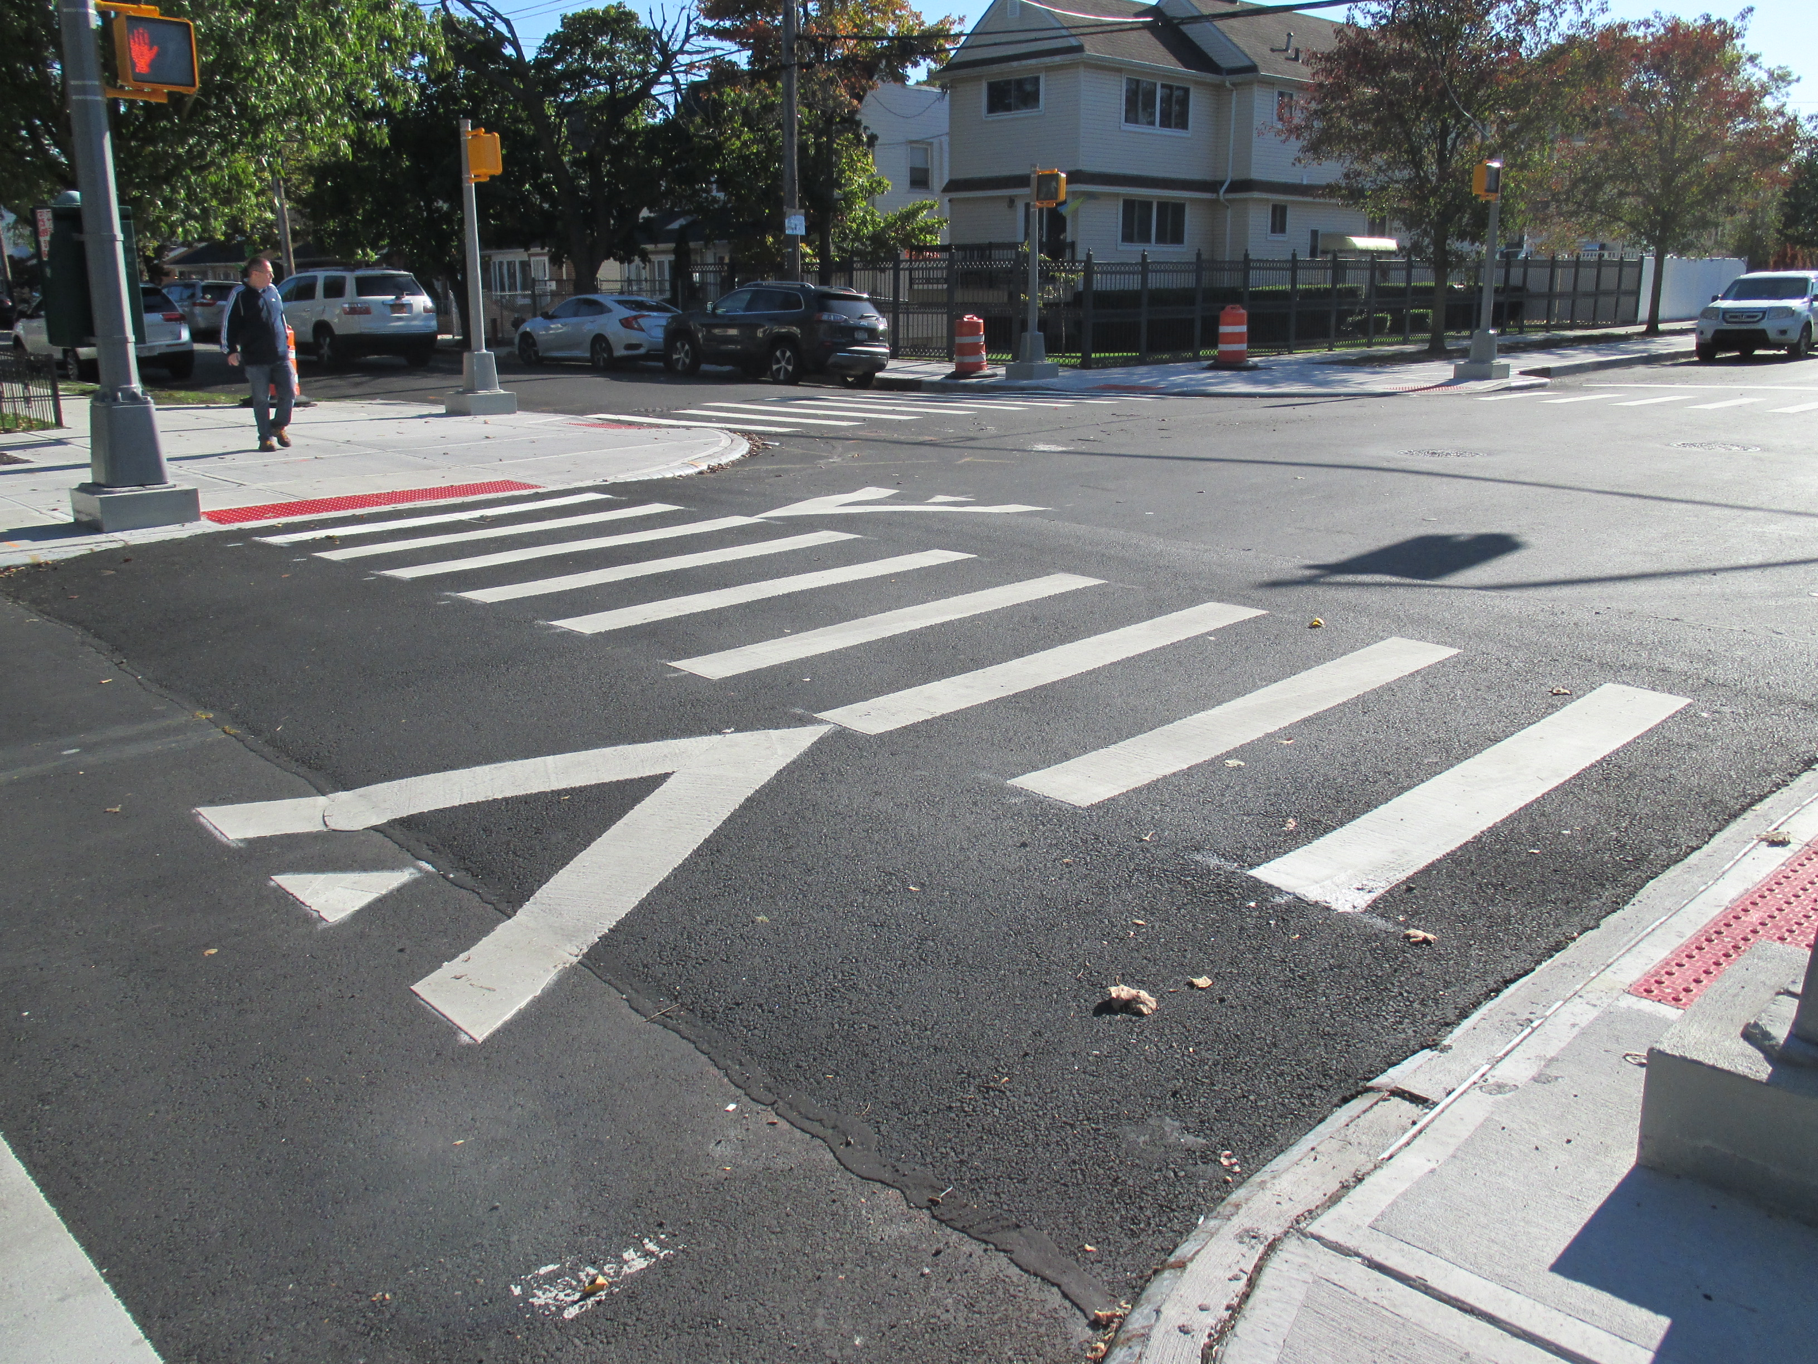
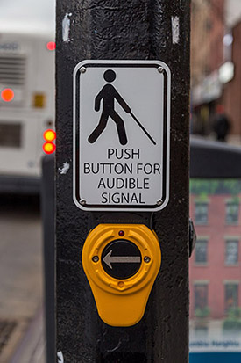
DDC DESIGN-BUILD RAISED CROSSWALKS
Sample Raised Crosswalk and Audible Pedestrian Sign (APS)
21

Slide 22
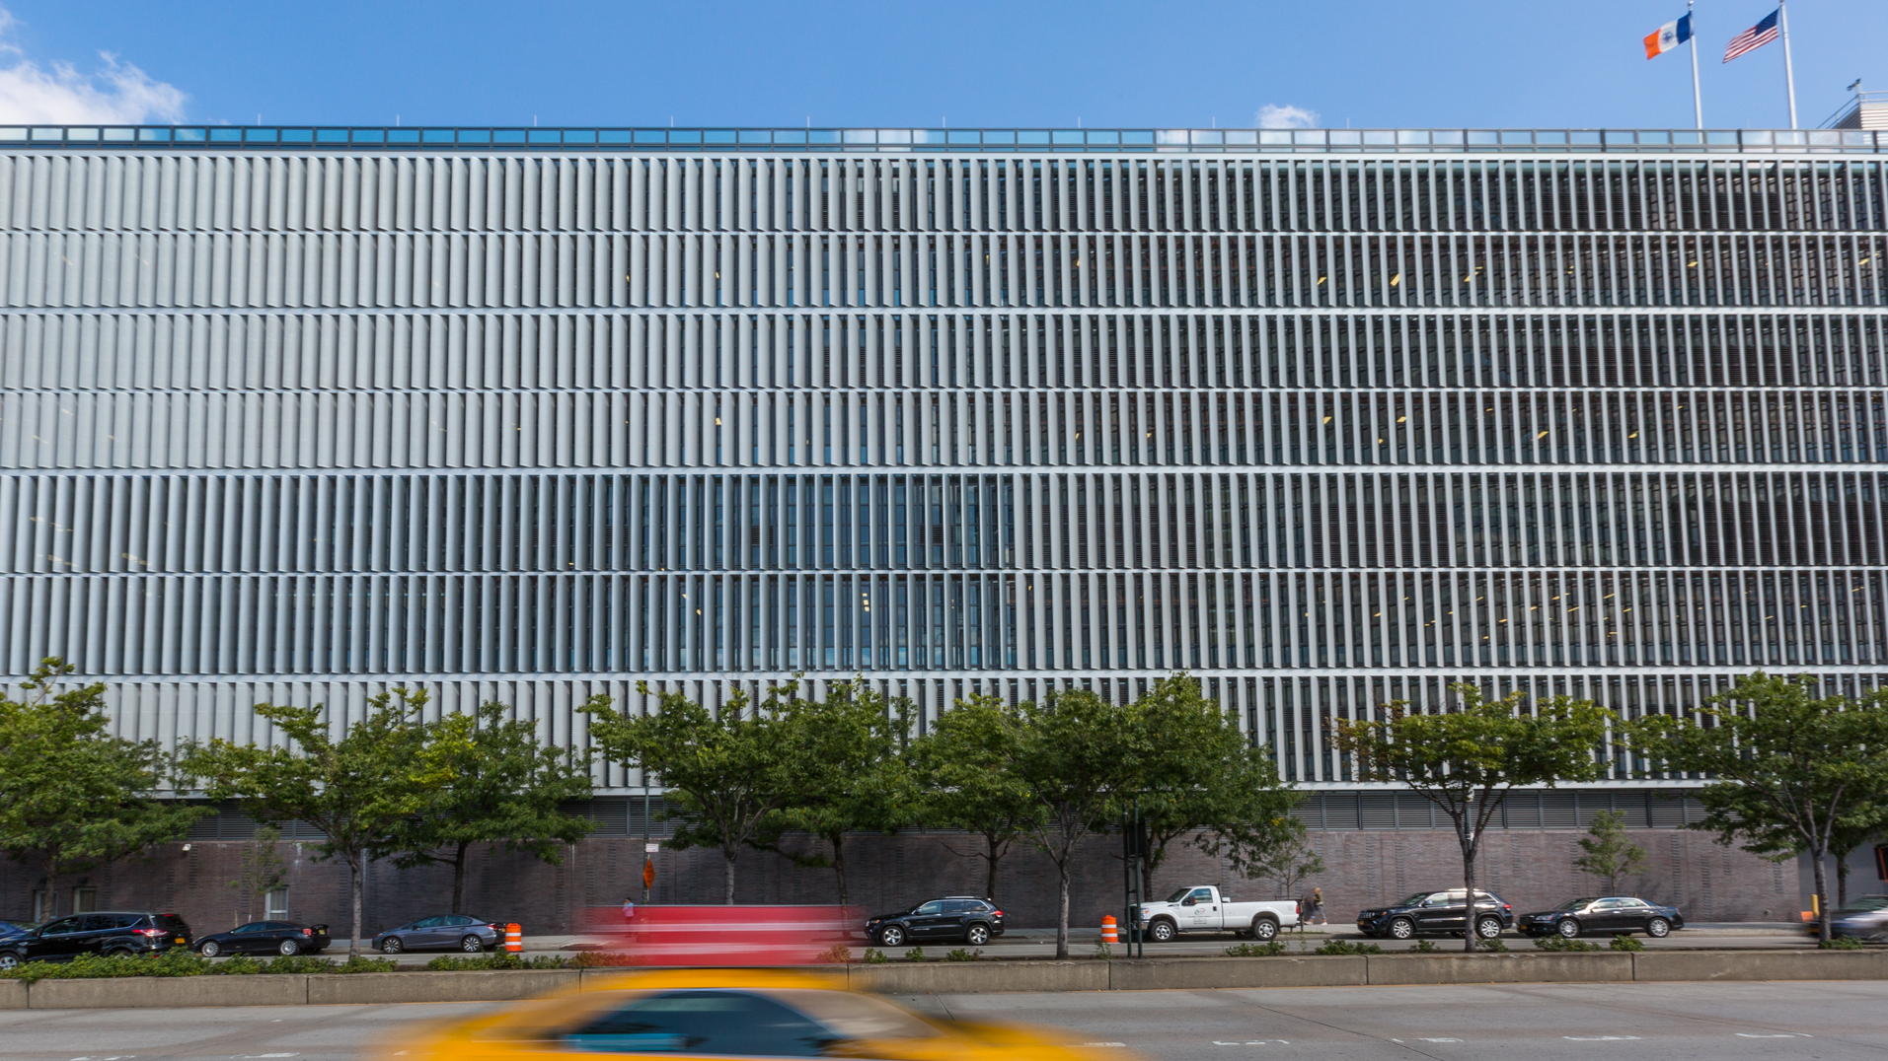
GENERAL PROCUREMENT INFORMATION
Judy Lee, Deputy Agency Chief Contracting Officer
Eric Adams
Mayor
Thomas Foley
Commissioner
Eric C Macfarlane, P.E. MASCE, NAC, ENV-SP First Deputy Commissioner
AUGUST 2023

Slide 23
Attendance
Please be sure to sign in. Attendance will be taken using the Microsoft Form link provided in the Webex chat.
This attendance sheet will be posted on our DDC website.

Slide 24
PASSPORT
Procurement and Sourcing Solutions Portal (PASSPort) - Disclosure Filing
All organizations intending to do business with the City of New York should complete an online disclosure process to be considered for a contract. This disclosure process was formerly completed using Vendor Information Exchange System (VENDEX) paper-based forms.
In anticipation of awards, proposers must create an online account in the new Procurement and Sourcing Solutions Portal (PASSPort) and file all disclosure information.
NO other types of disclosure filing will be accepted in lieu of PASSPort.
For more information, please visit nyc.gov/passport.

Slide 25
Request for QUALIFICATIONS: Key Dates
Procurement Process ​ | Timeline​
RFQ Release | August 14, 2023
RFQ (Step I) Questions and Comments Due ​ | September 8, 2023​ @ 4:00PM
Final Response to Proposer Questions​ | September 26, 2023
Statement of Qualifications Due ​ | October 3, 2023​ @ 4:00PM
Shortlisted Teams Announced​ | November 15, 2023​
Issue Draft RFP (Step II)​ | November 2023​
Final RFP​ | January 2024
Proposal Due ​ | February 2024
Contract Award​ | June 2024​
Notice to Proceed | September 2024​

Slide 26
Request for QUALIFICATIONS: Inquiries
Inquiries must be requested via link no later than:
4:00PM, September 8, 2023
Inquiries must be submitted to:
https://forms.office.com/g/m6nihR8nxT
Responses to RFIs will be posted on DDC website on September 26, 2023

Slide 27
Request for QUALIFICATIONS: SOQ contents
Proposers shall complete SOQ processes in PASSPort. The following files must be uploaded separately per direction in PASSPort.
1. SOQ
2. Doing Business Data Form (Exhibit E-2)
SOQs must be in accordance with Exhibit B2 and Exhibit B4 and submitted electronically no later than: 4:00 pm on October 3, 2023.
All Addenda are required to be acknowledged and included with the SOQ.

Slide 28
M / W B E
Ding ( Steven) Zheng , MWBE Outreach and Compliance Analyst
Eric Adams
Mayor
Thomas Foley, P.E.
Commissioner
August 2 0 2 3

Slide 29
MINORITY & WOMEN-OWNED BUSINESS ENTERPRISES: PARTICIPATION REQUIREMENTS
Design-Build Legislation
The legislation that authorizes DDC to use Design-Build as a capital project delivery method provides additional tools or opportunities to engage the M/WBE community in City capital projects.
As a result of this newly found flexibility, DDC now requires all Design Build teams to submit an “M/WBE Program Experience Form” at the RFQ stage.
M/WBE Participation goals on the Design and Construction phases will be disaggregated as follows:
10% Black American
10% Hispanic American
10% Unspecified
Firms will not be allowed to submit pre-proposal and pre-award waivers
The Office of Diversity and Industry Relations will monitor performance against M/WBE goals throughout the life of the project. We will work closely with the design-builder to make sure that they meet the goals.
29

Slide 30
MINORITY & WOMEN-OWNED BUSINESS ENTERPRISES: PARTICIPATION REQUIREMENTS
In order to facilitate meeting targets while maintaining a robust vendor pool, the Design-Build Program:
Allows for the use of state-certified M/WBEs in addition to city-certified M/WBEs
Eliminates any tier restrictions on eligible M/WBE participation
Counts suppliers at 60% of the subcontract value
30

Slide 31
MINORITY & WOMEN-OWNED BUSINESS ENTERPRISES: PARTICIPATION REQUIREMENTS
M/WBE Requirement can be achieved by:
M/WBE Prime Vendor
Qualified M/WBE Joint Venture
M/WBE Subcontractor(s)
New York City Department of Small Business Service certified M/WBE firms listed at: https://sbsconnect.nyc.gov/certification-directory-search/
New York State certified MWBE firms listed at: https://ny.newnycontracts.com//
31

Slide 32
Q U E S T I O N S ?
Eric Adams
Mayor
Thomas Foley, P.E.
Commissioner
August 2 0 2 3

Slide 33
T H A N K Y O U !
Eric Adams
Mayor
Thomas Foley, P.E.
Commissioner
August 2 0 2 3

